Slide 1

Machine Learning #3
Module Leader: Dr Grace U. Nneji

Slide 2
01
Rules
02
Learning outcomes
03
References
CONTENTS
04
Logistic Regression
05
Seminar Session 1
06
Sigmoid function
07
Seminar Session 2
08
Decision Boundary
09
Cost Function for Logistic Regression
10
Gradient Descent for Logistic Regression
11
Seminar Session 3

Slide 3

01
Rules
Be on time
Bring your stuff (Pen, papers, folder, brain)
No pressing of phone, or gaming in the class.
Habit of Effective learners.
Prepare for your coursework and exam on time.
Always revise your PPTs before and after class.
Have Fun

Slide 4
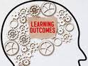
02
Learning Outcomes
Students will be able to:
learn the other type of supervised learning, classification.
learn how to predict categories using the logistic regression model.
practice implementing logistic regression
Implement gradient descent.
Optimize a logistic regression model using gradient descent.

Slide 5

03
References
1. Bishop, C. M. (2006). Pattern Recognition and Machine Learning. Springer.
2. Géron, A. (2019). Hands-On Machine Learning with Scikit-Learn, Keras, and TensorFlow. O'Reilly Media.
3. Murphy, K. P. (2012). Machine Learning: A Probabilistic Perspective. MIT Press.
4. Goodfellow, I., Bengio, Y., & Courville, A. (2016). Deep Learning. MIT Press.
5. Hastie, T., Tibshirani, R., & Friedman, J. (2009). The Elements of Statistical Learning: Data Mining, Inference, and Prediction. Springer.

Slide 6
04
Logistic Regression

Slide 7
04
Motivation
Binary Classification: classify or categorize into two class or category
Designated clauses for binary class: No or Yes, False or True, negative class or positive class, present or absent, bad or good, 0 or 1.
Multi-classification: more than two classes
Examples:
1. Different types of fruits: orange, banana, apple, etc
2. Vehicle brands: Tesla, Citroen, BMW, Chery, Volvo, etc
3. Name of countries: china, UK, Austria, Germany, etc
Question | Answer (No or Yes)
Is the tumor malignant? | No Yes
Are you a male or female? | No Yes

Slide 8
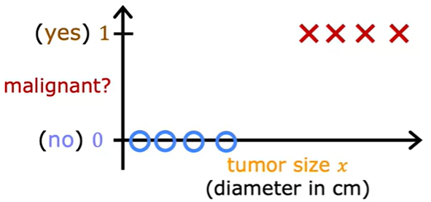
04
Motivation
Suppose we have a data to predict if a tumor size is malignant or not, what do we do look at this graph?
x-axis: tumor size x and the y-axis: malignant or not (in form of Yes or No)
What happen if we try to use linear regression model to fit a straight line to the data?
We should have something like this in the next slide.

Slide 9
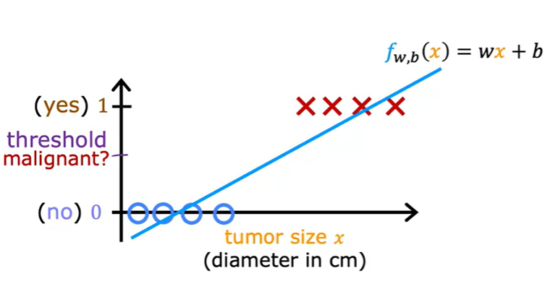
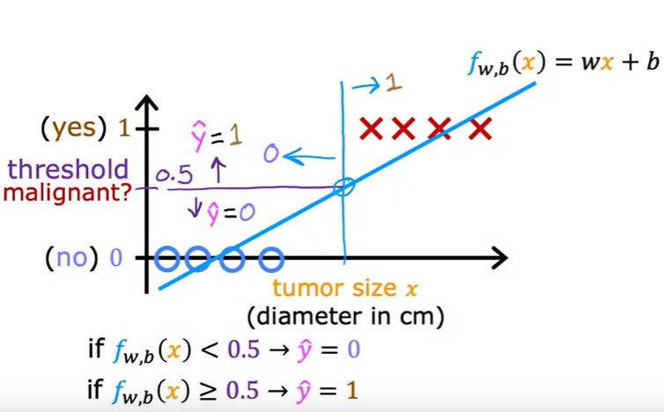
04
Motivation
Linear regression predicts not just the values
zero and one but all numbers between 0 and 1 or < 0 or > 1.
Therefore, we need to pick a threshold, let’s say 0.5. So that if the model outputs a value below 0.5, then you predict why equal zero or not malignant. And if the model outputs a number equal to or greater than 0.5, then predict y equals one or malignant.
Note, the threshold value of 0.5 intersects the best fit straight line at this point. So if you draw this vertical line here, everything to the left ends up with a prediction of y equals zero. And everything on the right ends up with the prediction of y equals one.

Slide 10
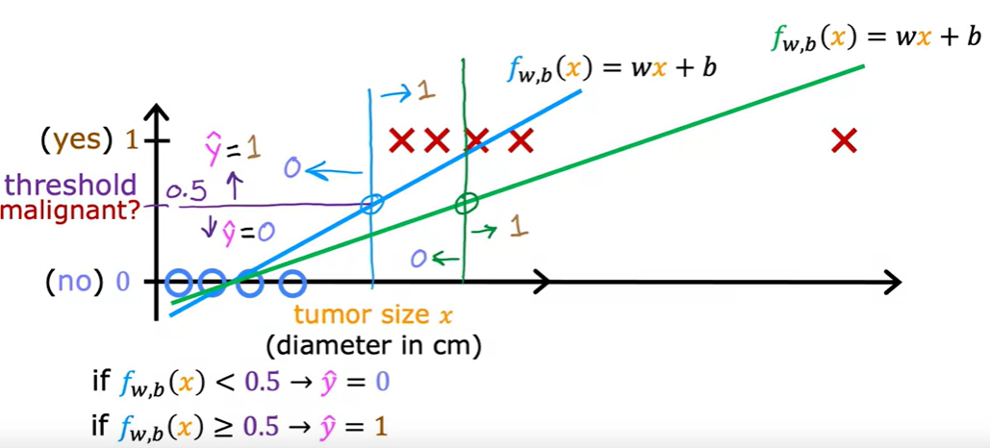
04
Motivation
What happens if we have one or more training example?
The best fit line for linear regression will shift over this (seen in the green straight line)
(new training example)
If we continue using the threshold of 0.5, you’ll notice that everything to the left of this point is predicted at zero non malignant and everything to the right of this point is predicted to be one or malignant.
However, this isn't what we want because adding that example way to the right shouldn't change any of our conclusions about how to classify malignant or not .
So, it is seems that if we try to do this with linear regression, adding this one example which feels like it shouldn't be changing anything it ends up with us learning a much worse function for this classification problem. This is the reason why we need LOGISTIC REGRESSION.

Slide 11
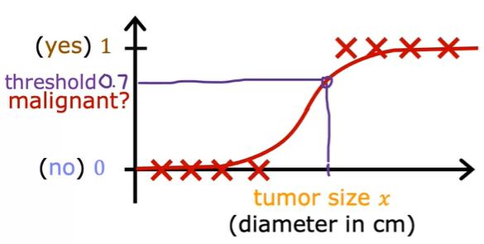
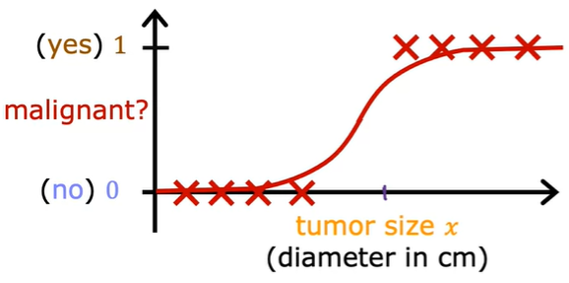
04
Logistic Regression
Now, we have considered why linear regression is not a good algorithm for the last slide problem.
While linear regression consider a best fit straight line, we could see that the expected fit here requires a curve in form of a S-shaped curve to this dataset. That is the concept of Logistic Regression.
To build a logistic regression algorithm, a function called Sigmoid or Logistic function is required.
With the application of logistic regression in the dataset, we can predict any unseen data if it is malignant or not (i.e benign) but also considering the threshold value, in this case threshold value = 0.7.
Let’s see and understand why we need the Sigmoid function as a best fit curve for the logistic regression model.

Slide 12
05
Seminar Session 1

Slide 13
05
Seminar Session (Instructions)
Let’s understand the logic between linear regression and logistic regression
Open the ‘w4_Linear_vs_Logistic_Regresion-Classroom_Exercise.ipynb’ file and let’s code together.
If you want to understand each line of code more. A word document file called ‘’Explanation for the line of codes’’ has been added to explain the code vividly for you.

Slide 14
05
Seminar Session on Cost Function
Open the jupyter notebook file titled
‘w4_Linear_vs_Logistic_Regresion-Classroom_Exercise.ipynb’
on your browser.

Slide 15
06
Sigmoid Function

Slide 16
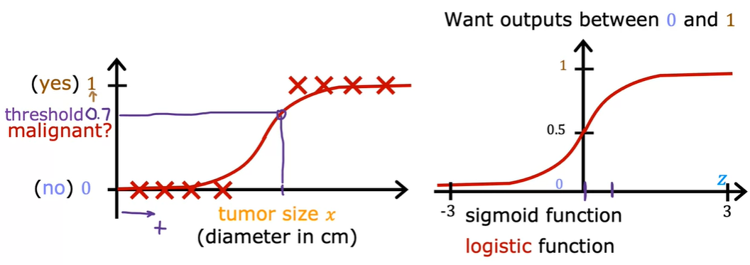
06
Logistic Regression with Sigmoid function

Slide 17
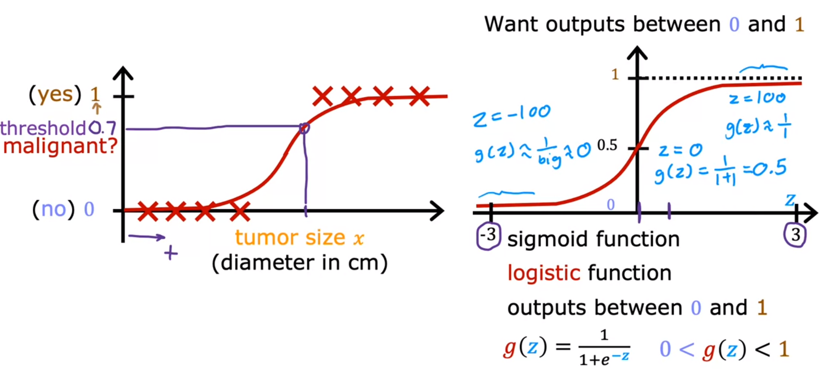
06
Sigmoid Function

Slide 18
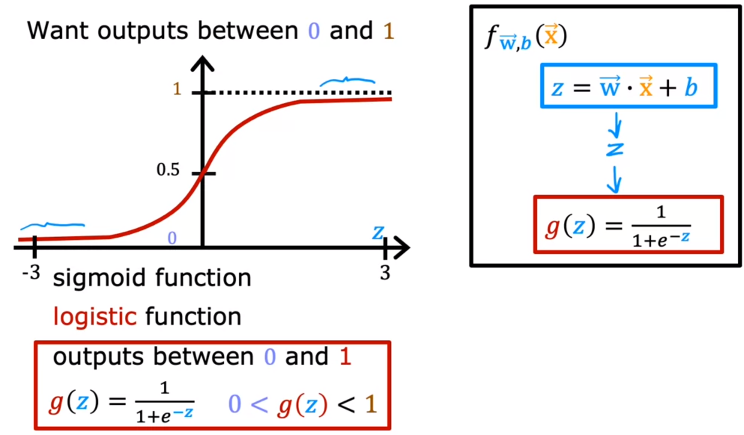
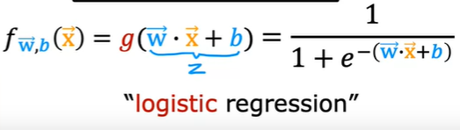
06
Logistic Regression

Slide 19
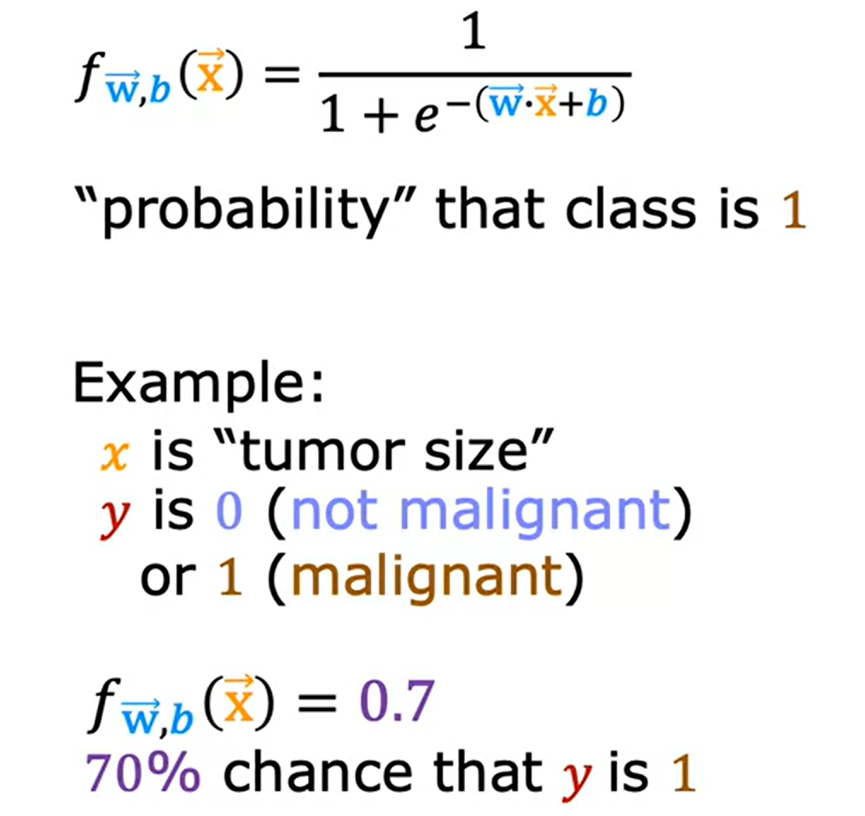
06
Interpretation of Logistic Regression Output
What is the chance that y is 0?
Answer:
P (y=0) + P (y+1) = 1
P (y=0) = 1 - P (y+1)
P (y=0) = 1 – 0.7
P (y=0) = 0.3
30% chance that y is 0

Slide 20
07
Seminar Session 2

Slide 21
07
Seminar Session (Instructions)
Let’s understand how Sigmoid Function works
You’ll explore the sigmoid function (also known as the logistic function)
You’ll explore logistic regression; which uses the sigmoid function
Open the ‘w4_Sigmoid_Function.ipynb’ file.

Slide 22
09
Seminar Session on Cost Function
Open the jupyter notebook file titled
‘w4_Sigmoid_Function.ipynb’
on your browser.

Slide 23
08
Decision Boundary

Slide 24
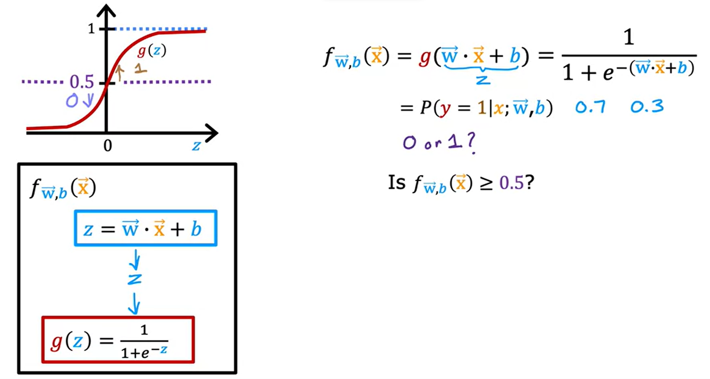
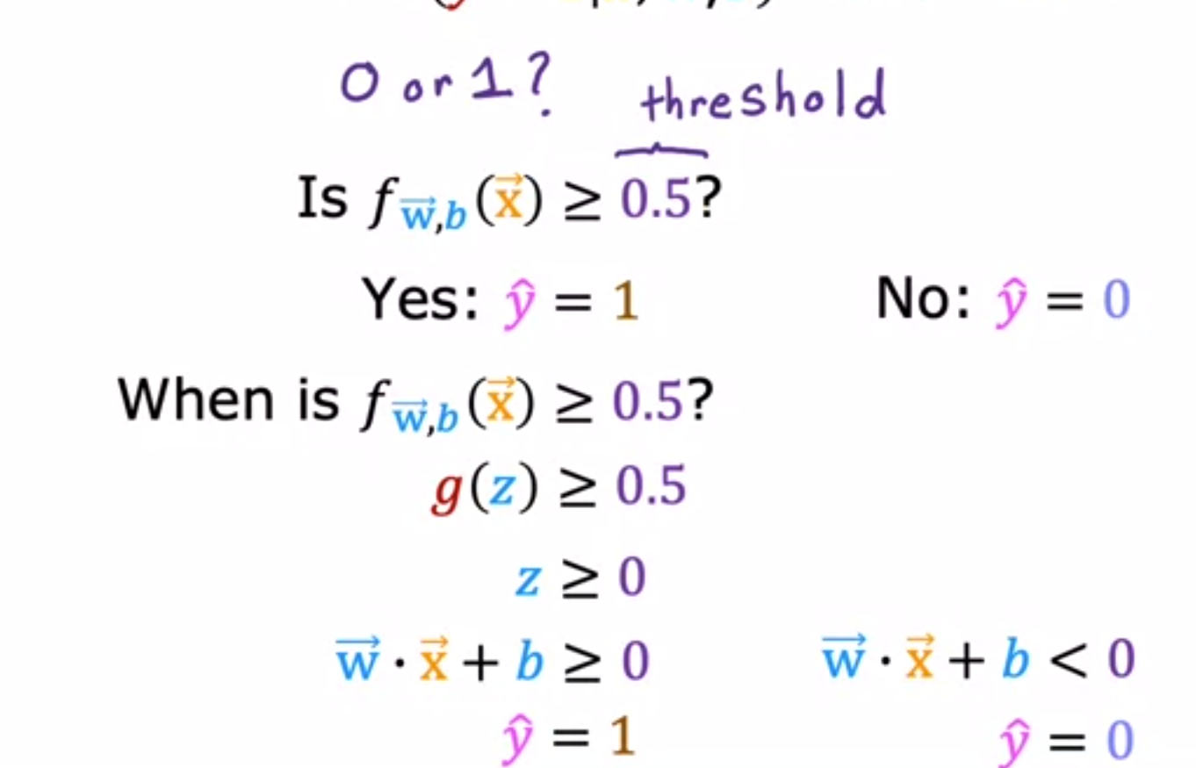
08
Decision Boundary
Recall the logistic regression model which of two steps:
You compute, z= wx + b
Then, apply the sigmoid function g to this value z.
Next, if we want our algorithm to predict if y= 0 or y=1 as we did through the probability of the previous slide, then there is need for a threshold value.
A common threshold value could be 0.5.

Slide 25
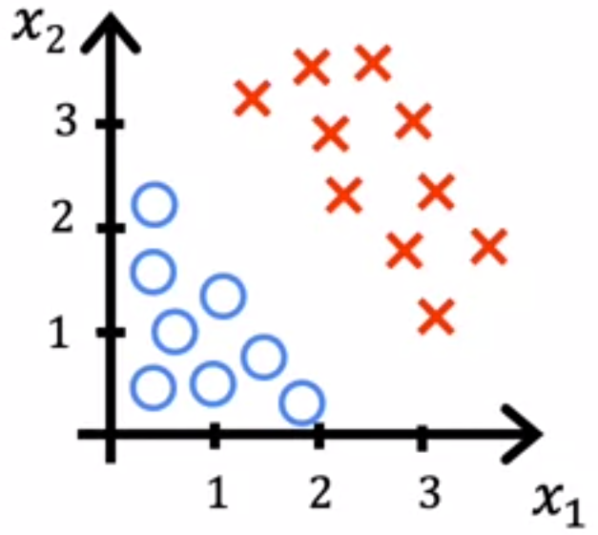
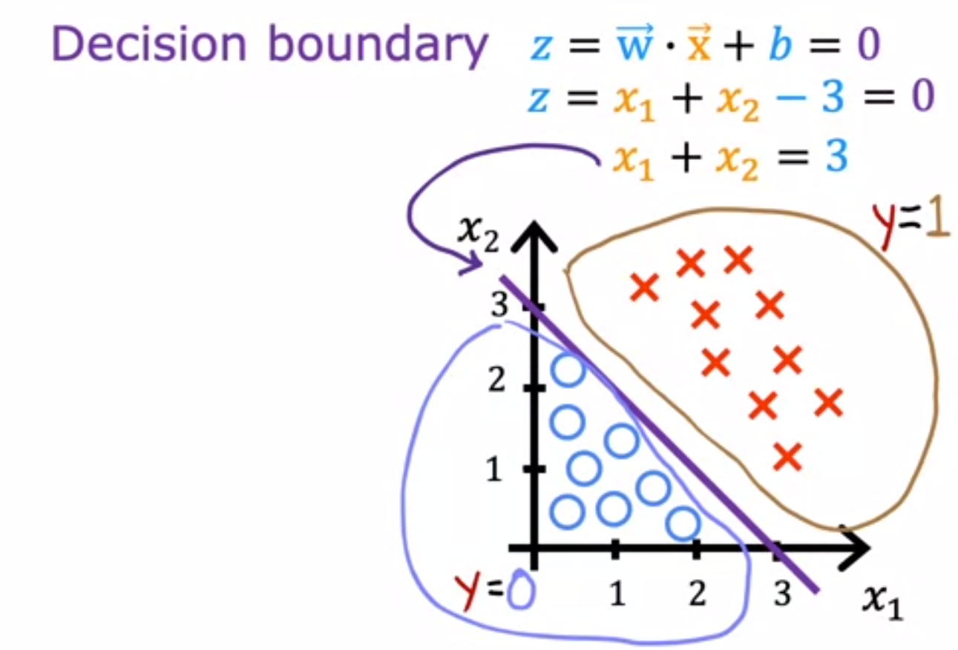
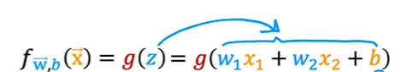
08
Decision Boundary
Consider a training set where the little red crosses denote the positive examples and the little blue circles denote negative examples.
The red crosses corresponds to y=1, and the blue circles correspond to y=0. The logistic regression model will make predictions using
If w₁=1, w₂=1, and b= -3, then we have;
The logistic regression model will make predictions using

Slide 26
09
Cost Function for Logistic Regression

Slide 27
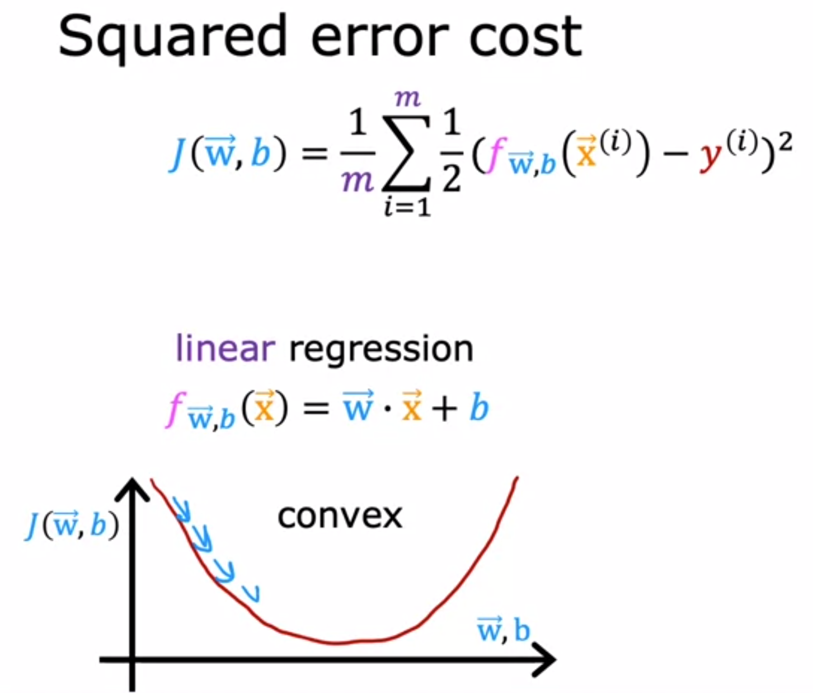
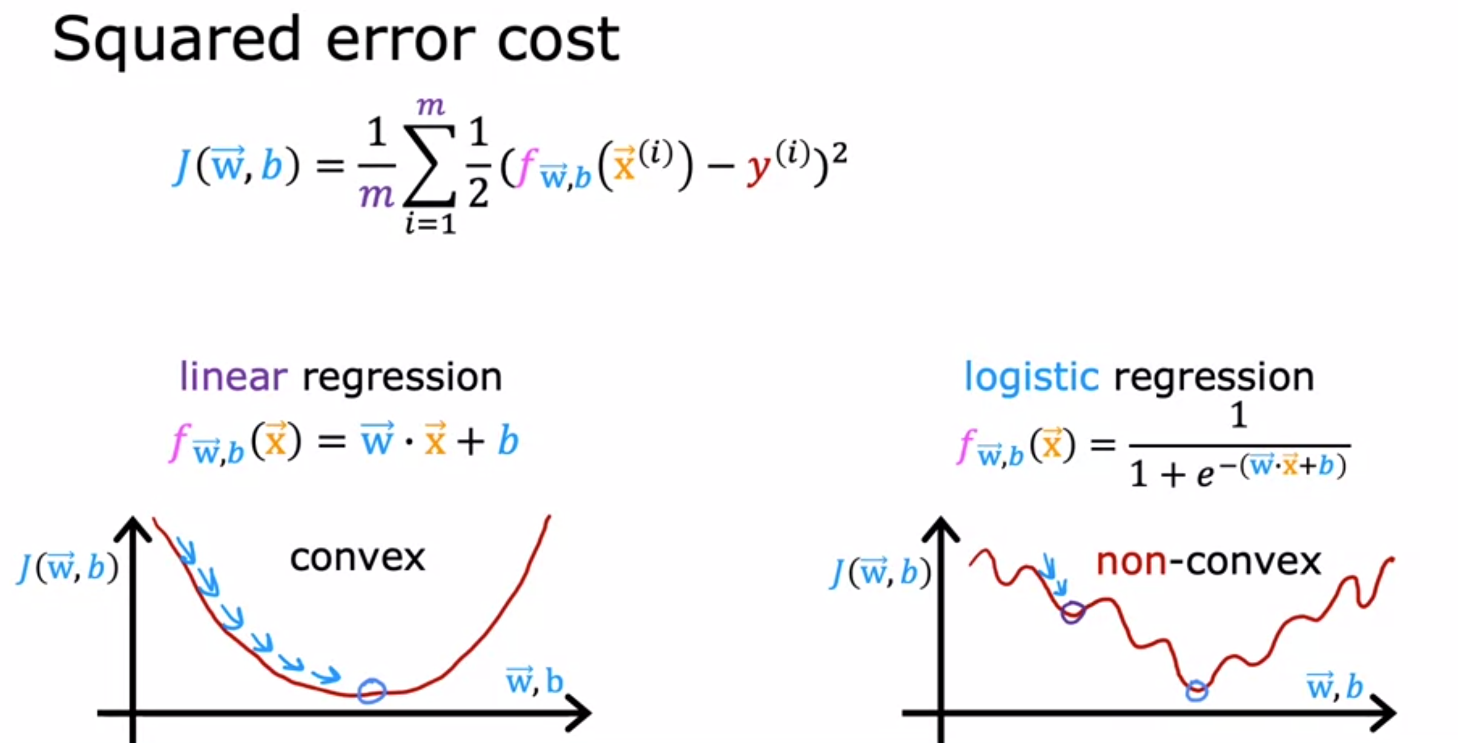
09
Cost Function for Logistic Regression
Recall the mse formula for the cost function of the linear regression model, what happens if we want to applied it to logistic regression model?
It becomes non-convex cost function, thus stucking us with lots of local minima. Therefore, we need to apply another type of cost function as squared error is not a good choice

Slide 28
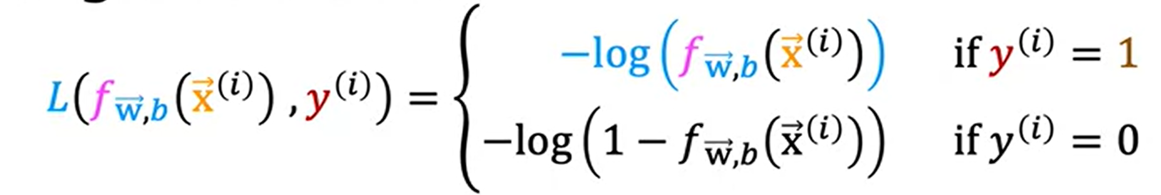
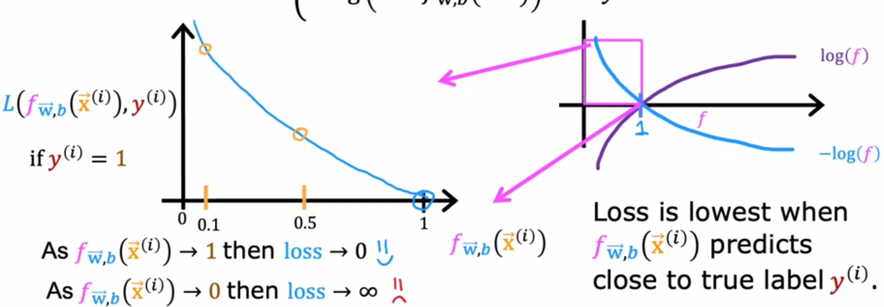
09
Logistic Loss Function

Slide 29
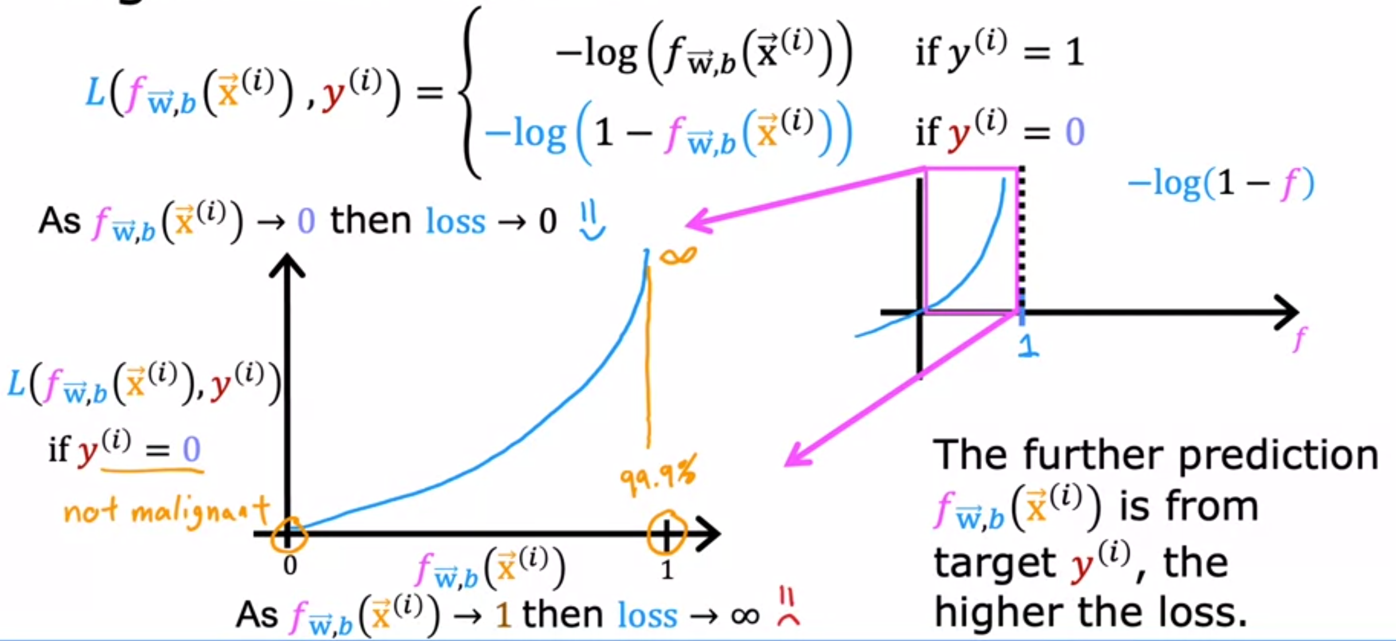
09
Logistic Loss Function

Slide 30
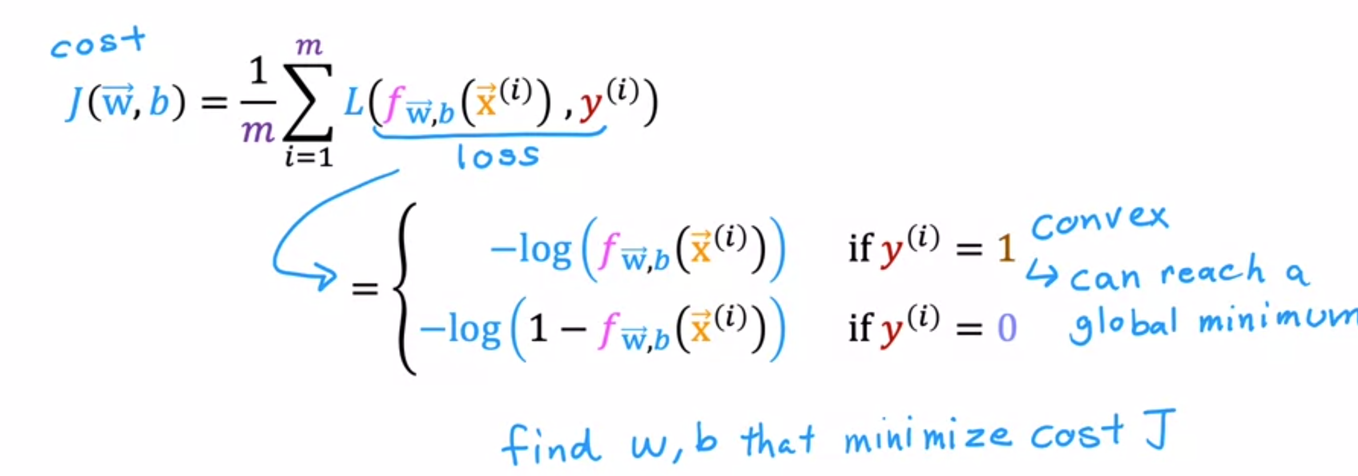
09
Logistic Loss Function

Slide 31
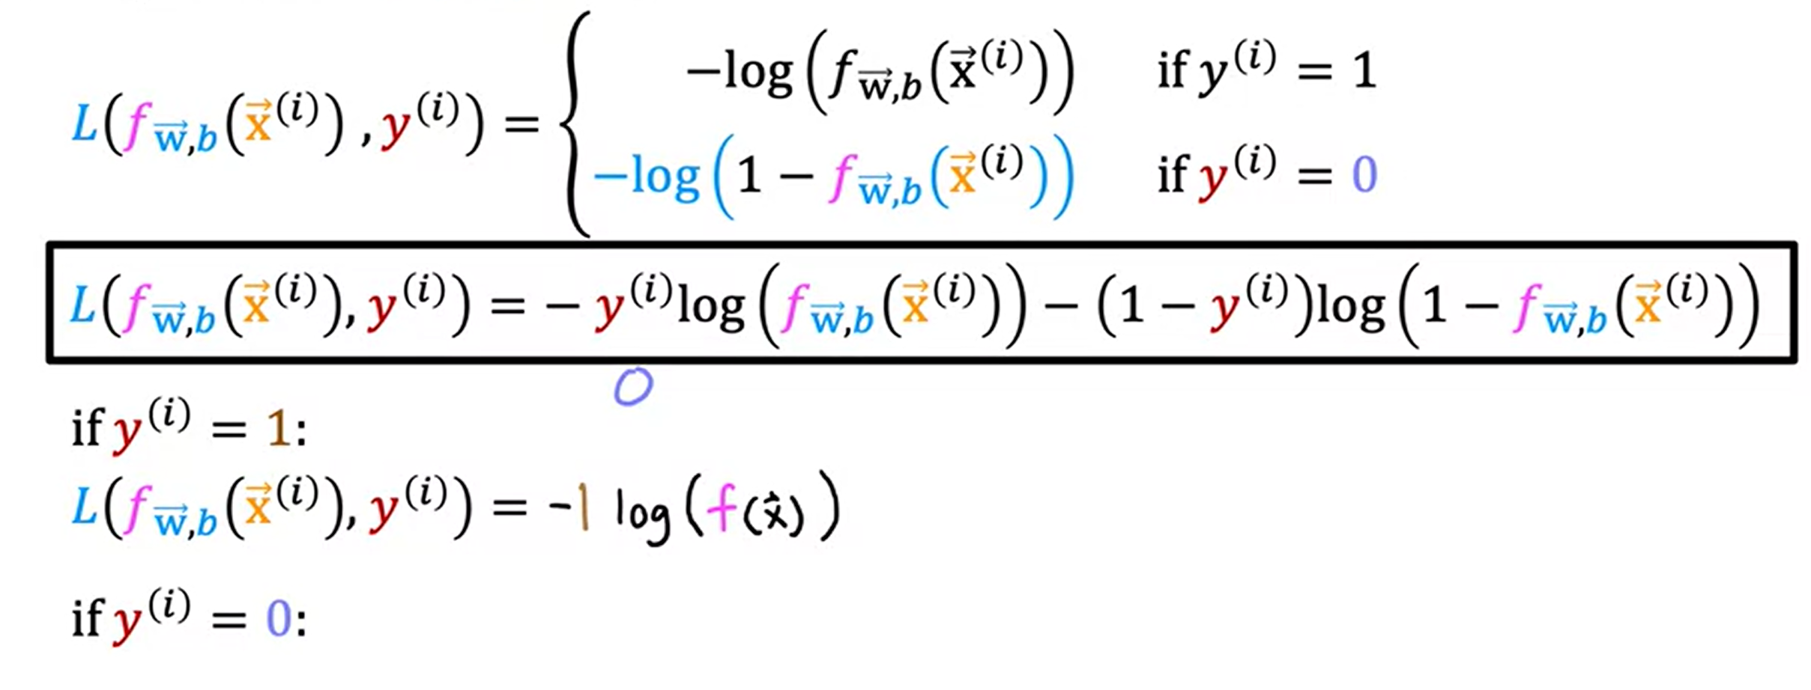
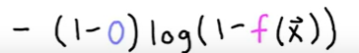
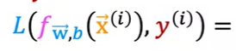
09
Simplified Loss Function

Slide 32
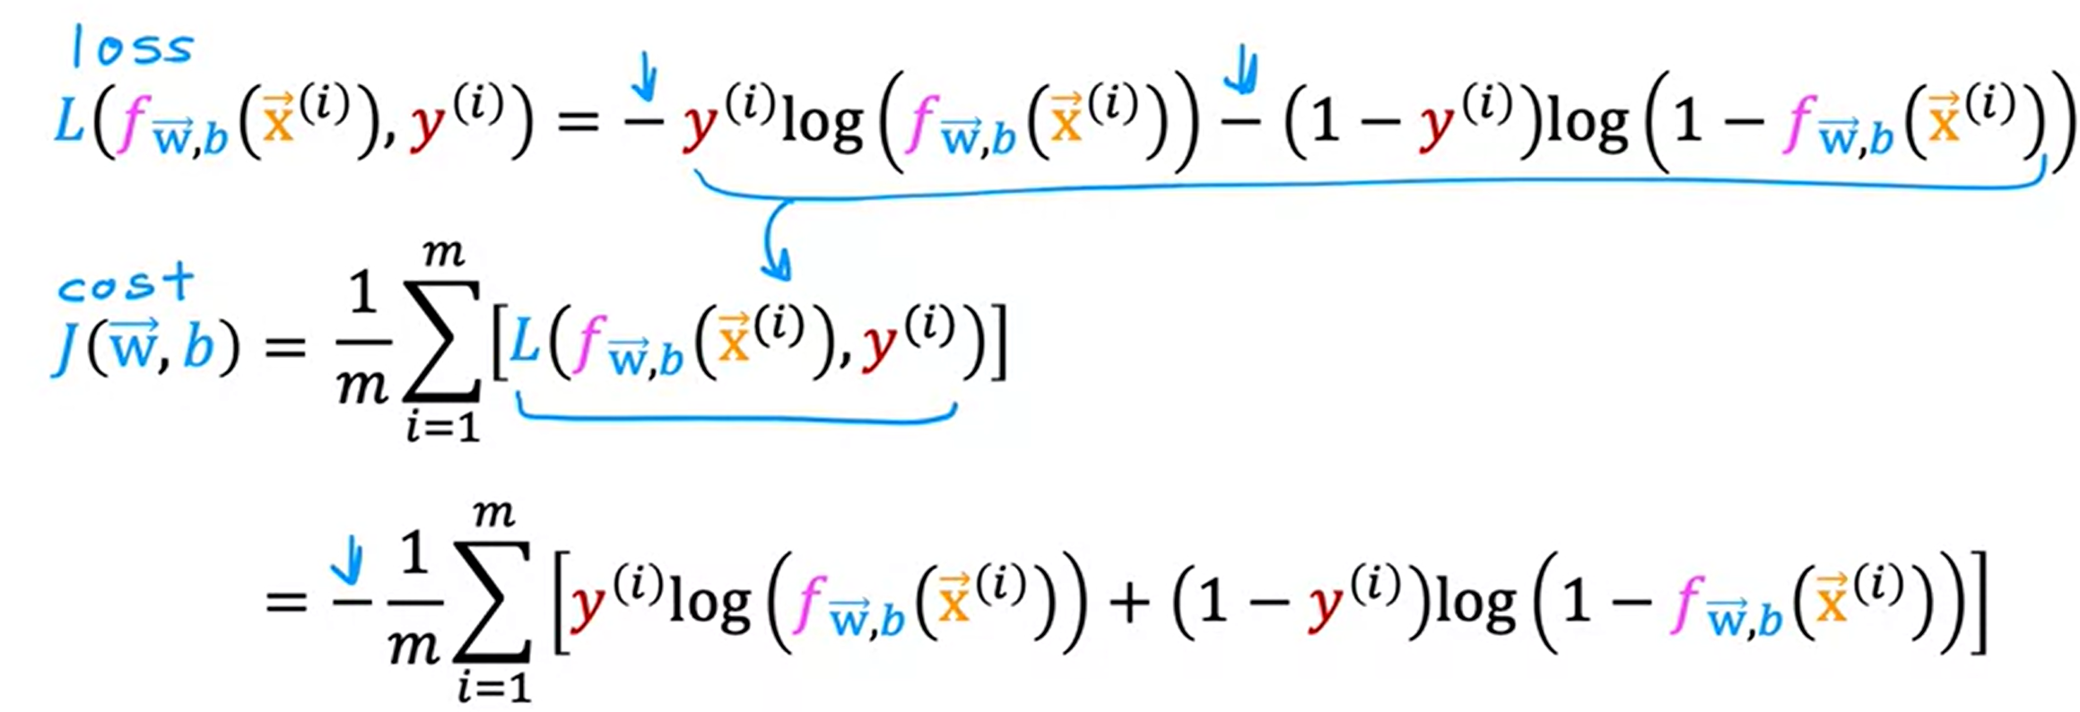
09
Simplified Cost Function

Slide 33
10
Gradient Descent for Logistic Regression

Slide 34
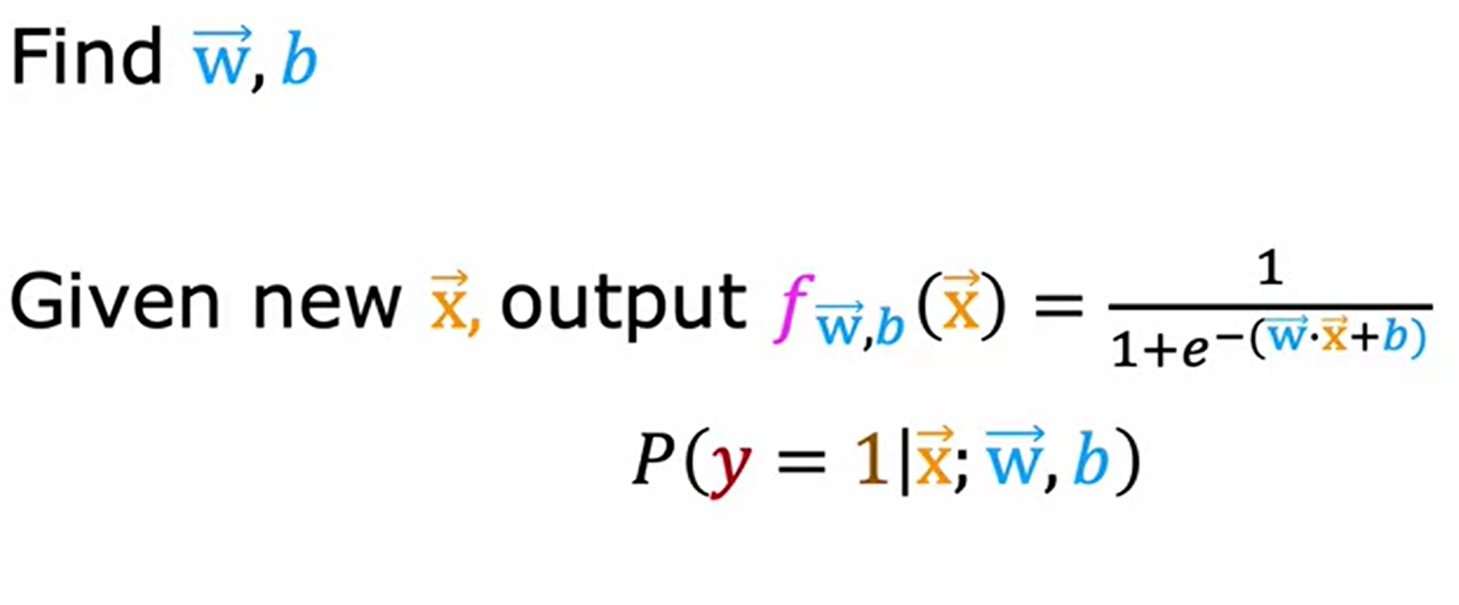
10
Gradient Descent Implementation
Training Logistic Regression
To fit the regression model, we need to find values of the w and b parameters that minimizes the cost function, J, and we’ll again apply gradient descent to do this.

Slide 35
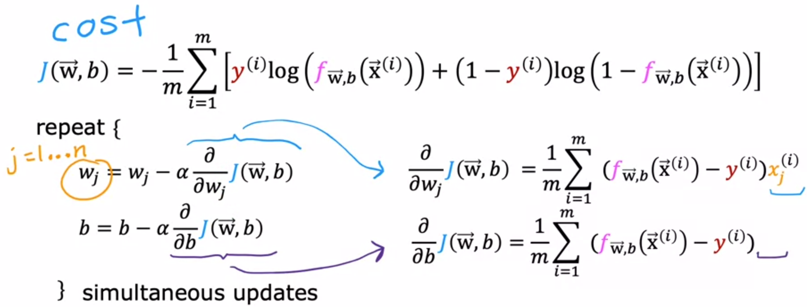
10
Gradient Descent Implementation
If you want to minimize the cost, J as a function of w and b, well, here's the usual gradient descent algorithm, where you repeatedly update each parameter as the 0 value minus Alpha, the learning rate times this derivative term.

Slide 36
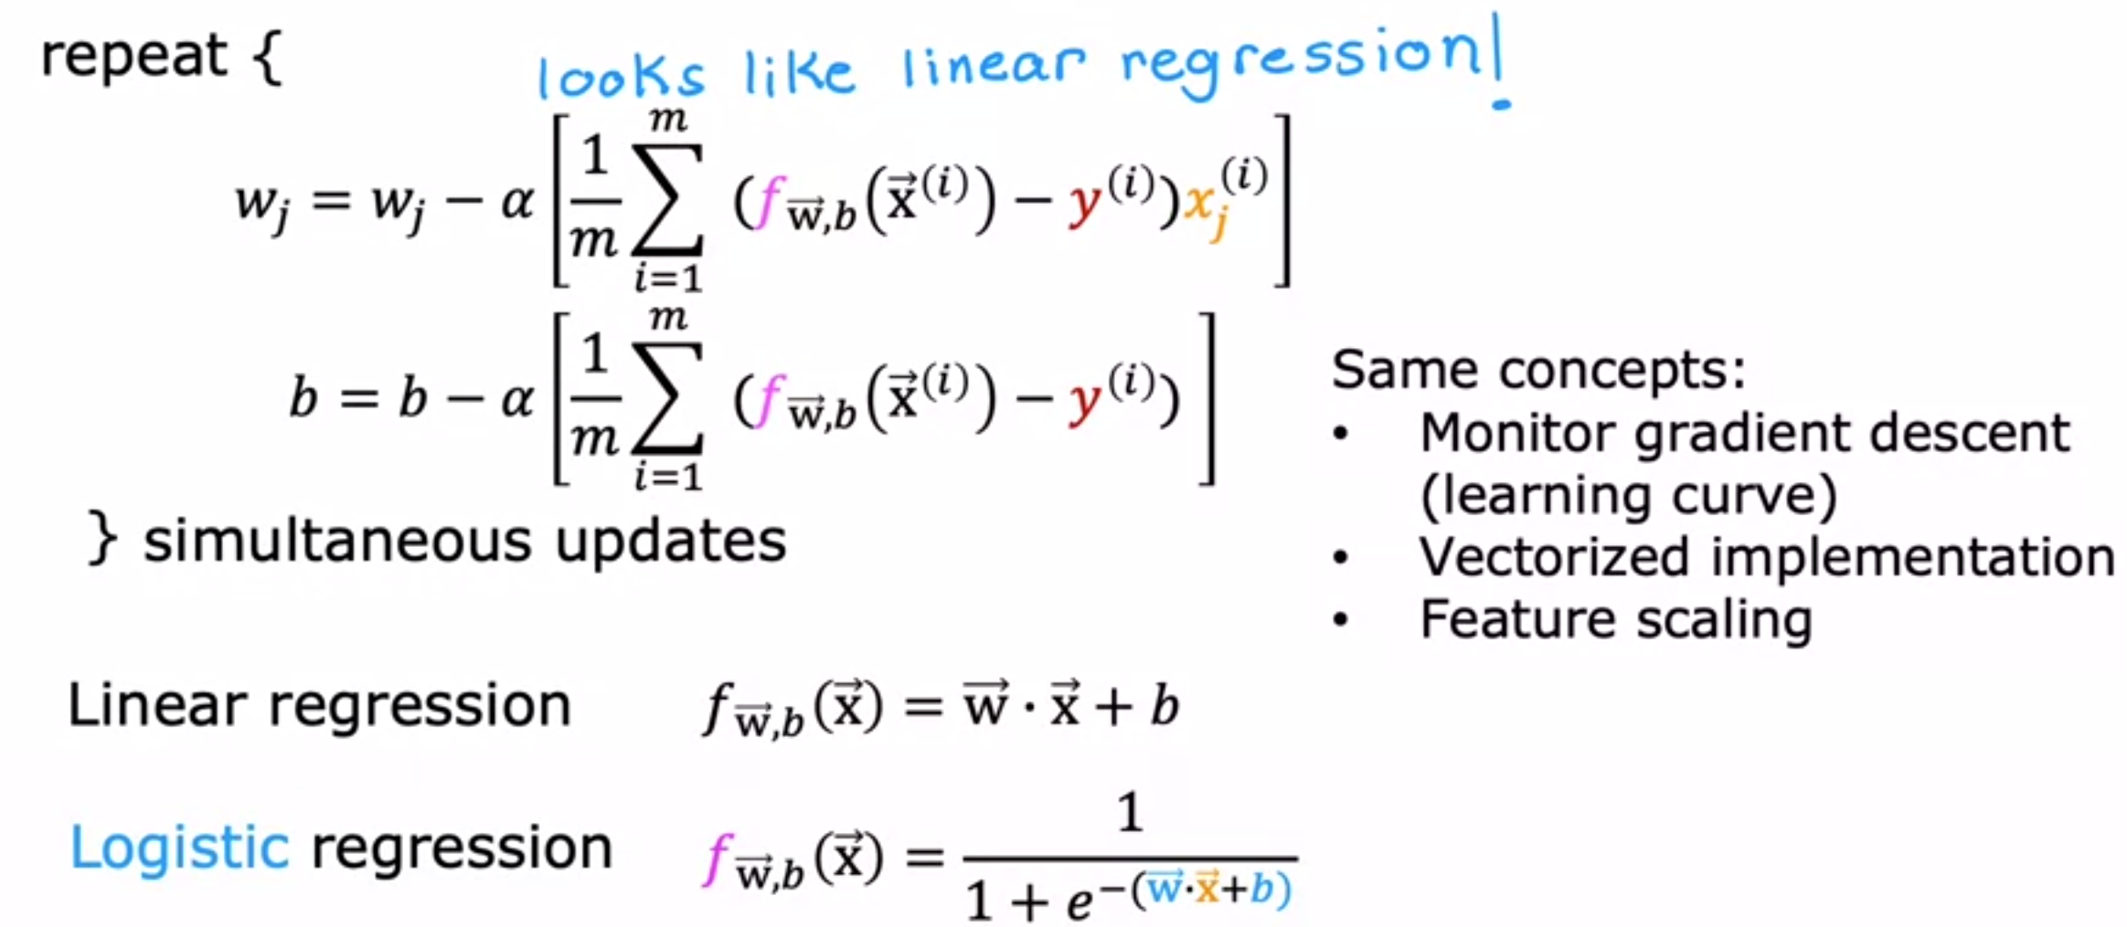
10
Gradient Descent for Logistic Regression

Slide 37
09
Seminar Session on Cost Function
Open the jupyter notebook file titled
‘W4_Gradient_Descent for Logistic Regression.ipynb’
on your browser.

Slide 38
Thanks for Listening

